Slide 1

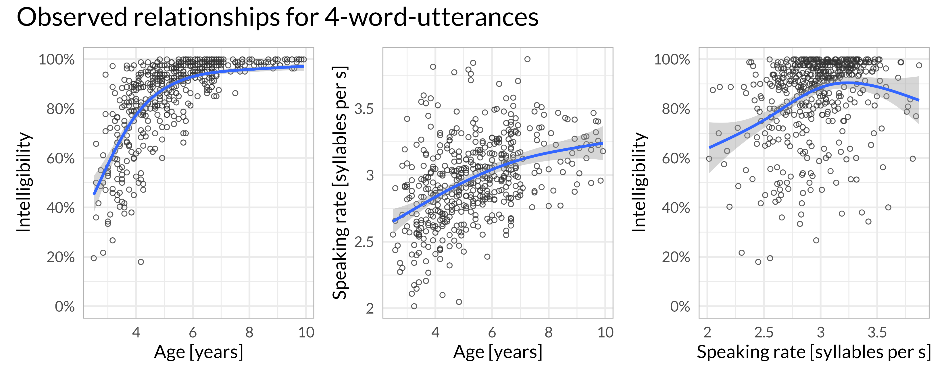
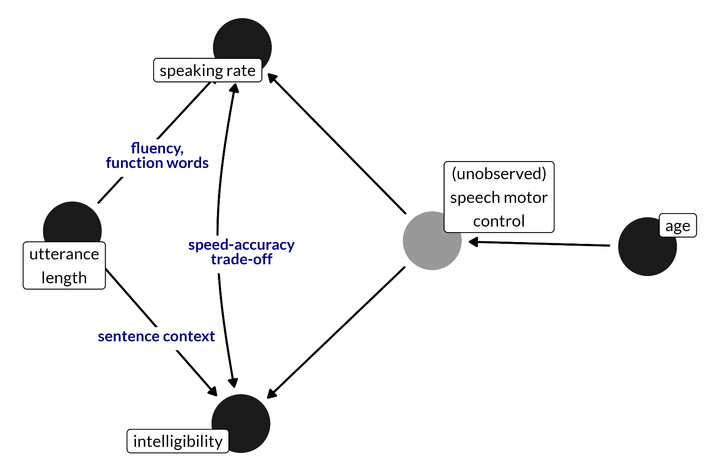
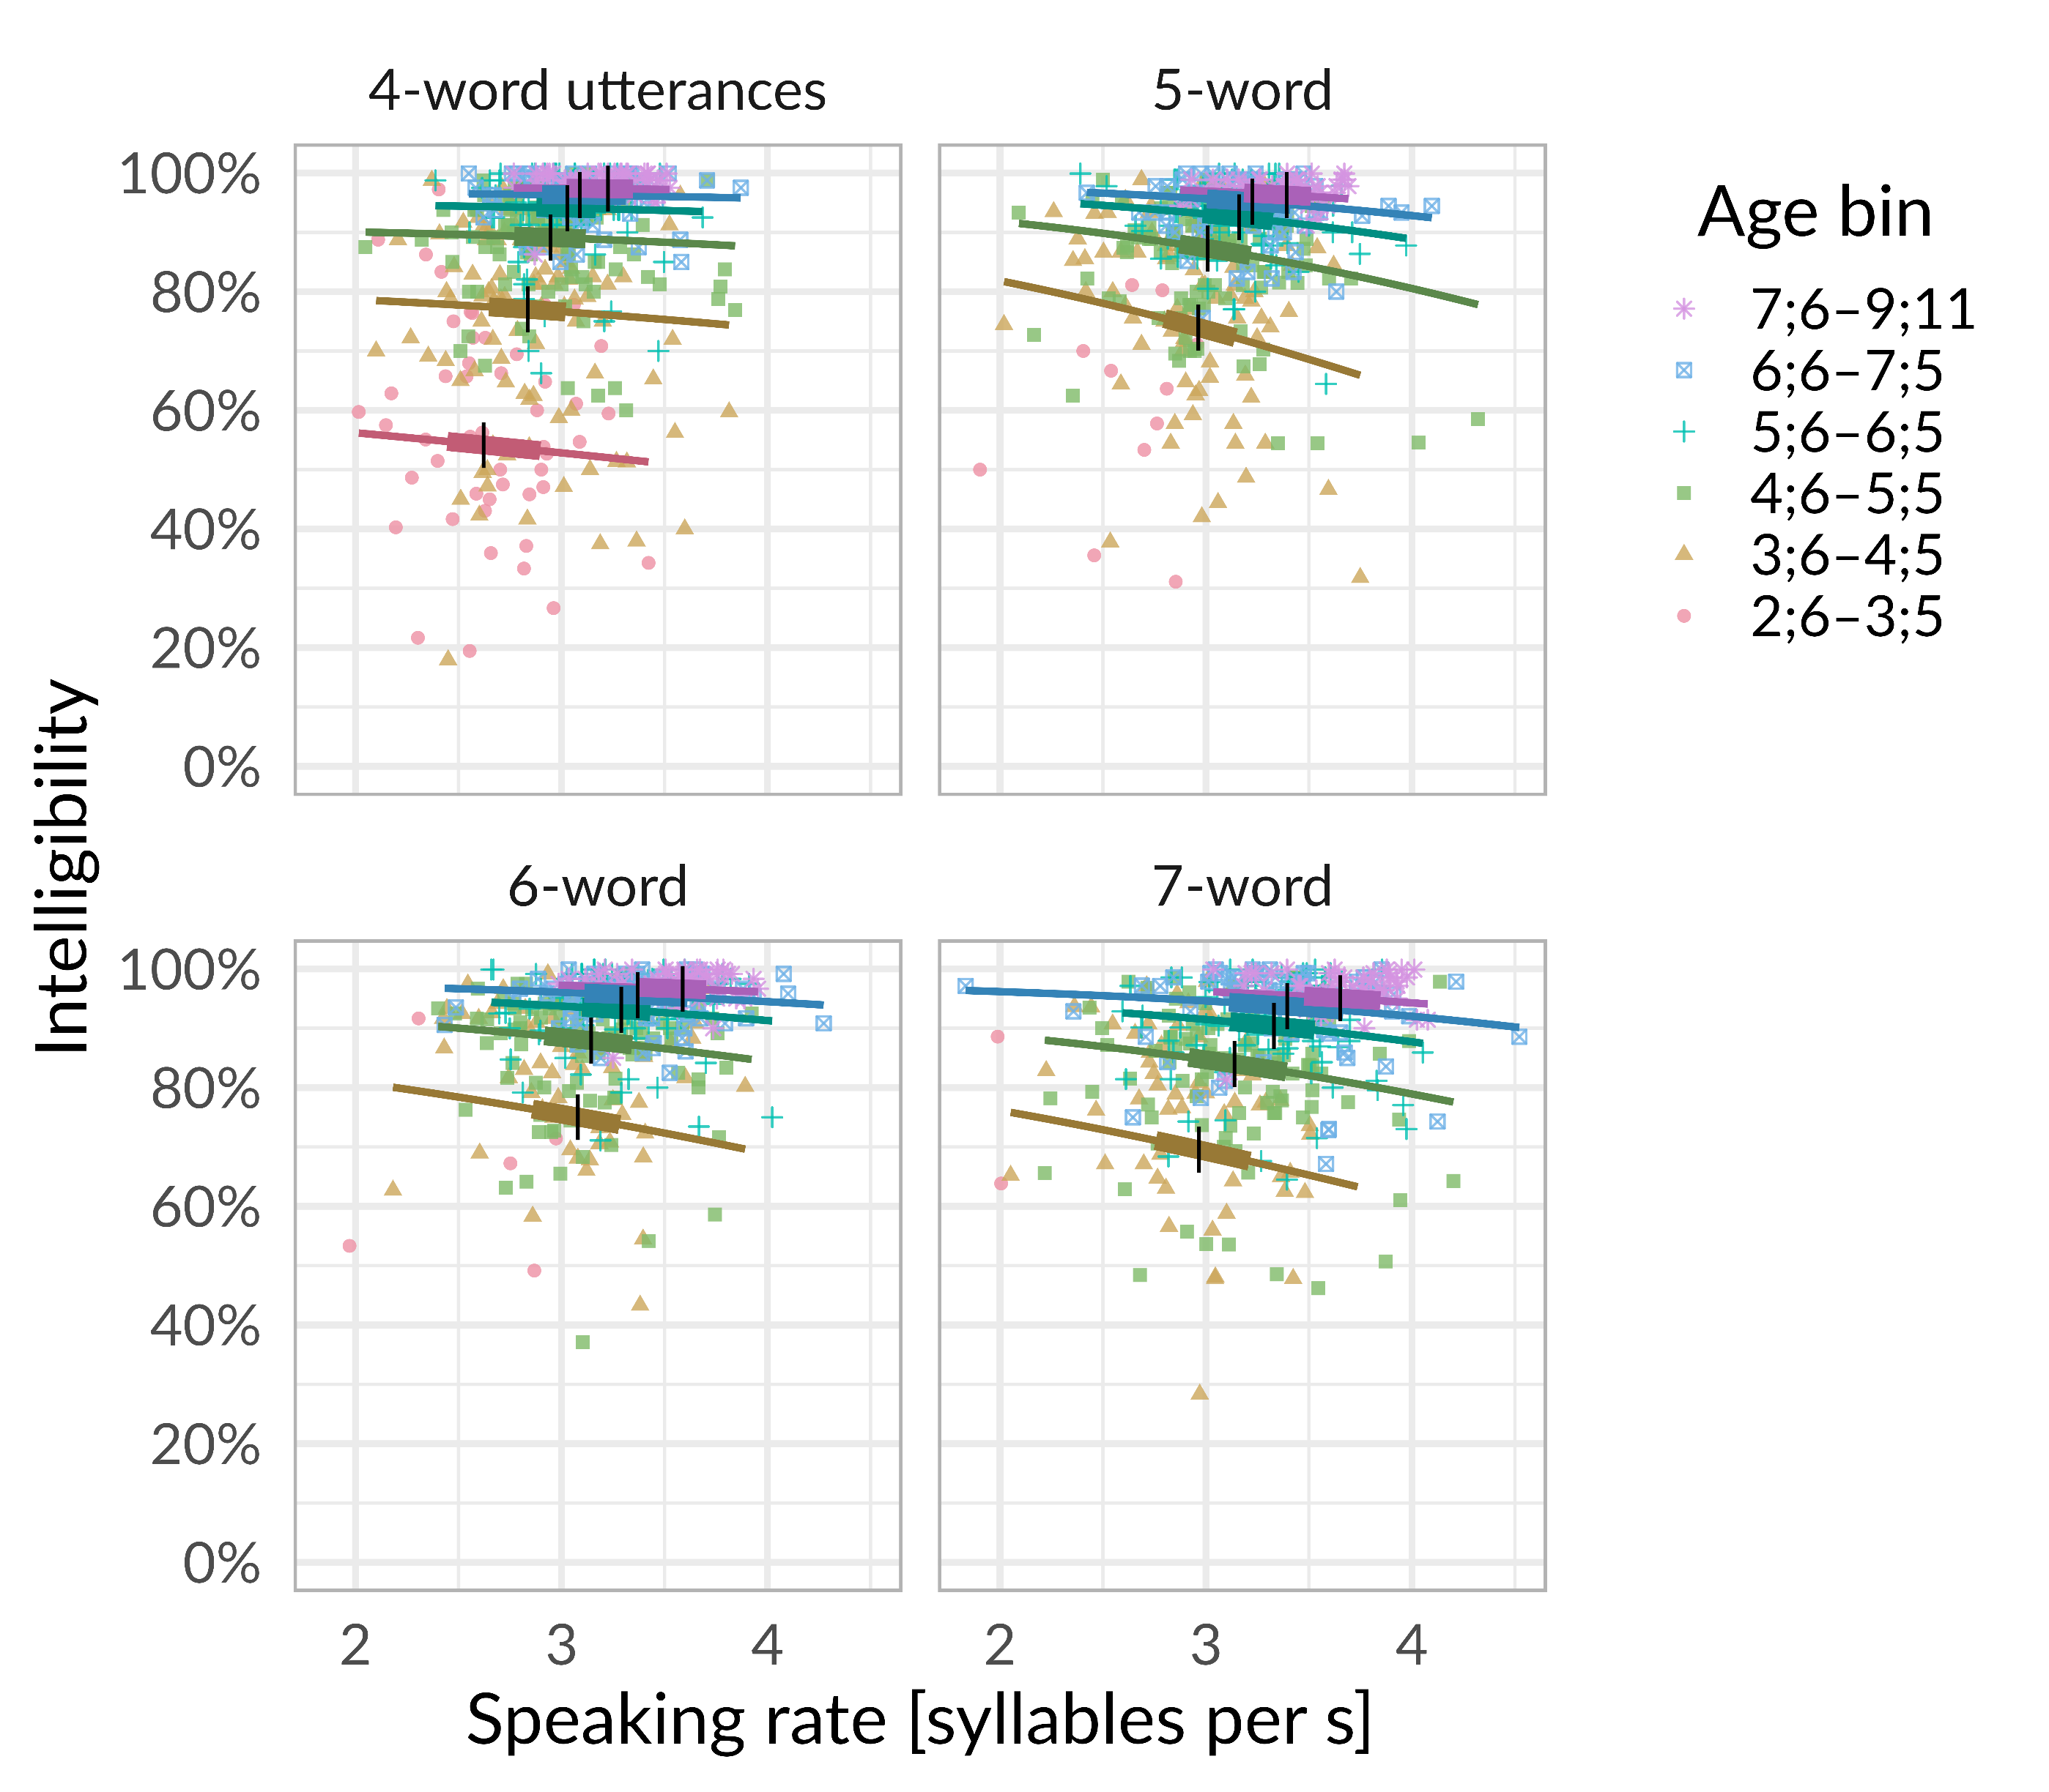
Speaking rate and intelligibility in children’s speech
Tristan Mahr, Katie Hustad University of Wisconsin–Madison
Background
Our prior work developed percentile growth curves for articulation rate and intelligibility in typically developing children between ages 2;6 and 9;11.
We found positive effects of age and utterance length:
Older children had faster, more intelligible speech productions on average.
Longer sentences prompted faster, more intelligible productions
Method
Participants
538 typically developing children between ages 2;6 and 9;11
Speech measures
Children repeated 2–7-word sentences.
For each child, two unique untrained listeners transcribed children’s utterances; they were played the productions and instructed to type out the words the child said.
A child’s intelligibility was the percentage of words correctly identified by listeners.
We force-aligned utterances using the Montreal Forced Aligner to determine start and end of speech.
Speaking rate was number of syllables per second.
We computed average rate and intelligibility stratified by utterance length. We only examined 3–7-word utterances.
Example data. Age is related to intelligibility and speaking rate. There is a suggestive decrease in intelligibility at the highest rates, but this effect is confounded by age.
Bayesian mixed effects analysis
We regressed intelligibility onto a 3-d.f. spline for age, utterance length, rate, and a length-by-rate interaction.
We included by-child random intercepts and by-child length-by-rate interactions.
On each posterior draw, we simulated one new child and computed their expected intelligibility at each rate × length × age. We averaged these simulated participants together to compute marginal means for intelligibility.
Marginal means of intelligibility by speaking rate, age and utterance length. Points represent observed intelligibility scores. Lines represent marginal means (population averages); these are expected intelligibility scores after averaging over between-child variability. Lines contain boxplot landmarks: Vertical marks represent the medians and thicker intervals contain the middle 50% of the observed data.
Effects of rate changes on intelligibility
We simulated 100 participants on each posterior draw and computed the mean of the participants on each draw. We summarized these simulated sample means with the posterior median and 95% quantile interval.
Increasing rate from 3.0 to 3.5 syllables per s for a 4-year-old:
4 words: changes intelligibility by −1 [−3, 1] (76% → 75%)
5 words: −5 [−7, −3] (73% → 68%)
6 words: −3 [−5, −1] (75% → 72%)
7 words: −4 [−6, −2] (69% → 64%)
… for a 6-year-old
4 words: changes intelligibility by 0 [−1, 0] (94% → 94%)
5 words: −2 [−3, −1] (93% → 91%)
6 words: −1 [−2, 0] (94% → 93%)
7 words: −1 [−3, −1] (91% → 90%)
Average observed SD of rate for each age-bin × length: .29
Discussion
Speaking rate and intelligibility both increase with age, consistent with a shared developmental cause.
After stratifying by utterance length and adjusting for age, there was a negative effect of speaking rate on intelligibility, suggesting a speed-accuracy trade-off.
This effect is small and practically negligible after 5;0, but for younger children and for longer, more demanding utterances, the effect is more noticeable.
Limitations
Speaking rates here are habitual rates in a sentence-repetition task meant to reduce other task demands (like sentence formulation). We might be underestimating the effect compared to spontaneous speech.
We did not manipulate rate. A within-child design that manipulated speaking rate would more directly test for the speed-accuracy tradeoff.
Participants were typically developing children, so the dynamic in a dysarthric population is unclear.
Current study
How are rate and intelligibility related? We examine two possible relationships:
Speech-motor control as common cause. Children with faster speaking rates have greater speech-motor control and thus higher intelligibility.
Speed-accuracy tradeoff. Increased rates are associated with reduced intelligibility.
Analysis framework. Age is a proxy for speech-motor control development.
Age Range | 2;6–3;5 | 3;6–4;5 | 4;6–5;5 | 5;6–6;5 | 6;6–7;5 | 7;6–9;11
N | 105 | 111 | 110 | 96 | 66 | 55
The authors have no financial or non-financial conflicts of interest.
Funding by NIDCD R01 DC015653 and supported in part by NICHD P50HD105353.
Conference on Motor Speech
San Diego, CA: February, 2024
Contact: Tristan Mahr (tristan.mahr@wisc.edu)

